Slide 1

Unsupervised Learning

Slide 2







Machine Learning - Types
Classification
Supervised
Regression
Unsupervised
Human Supervision?
Reinforcement
Machine Learning
Learn Incrementally?
How they generalize?
Machine Learning

Slide 3
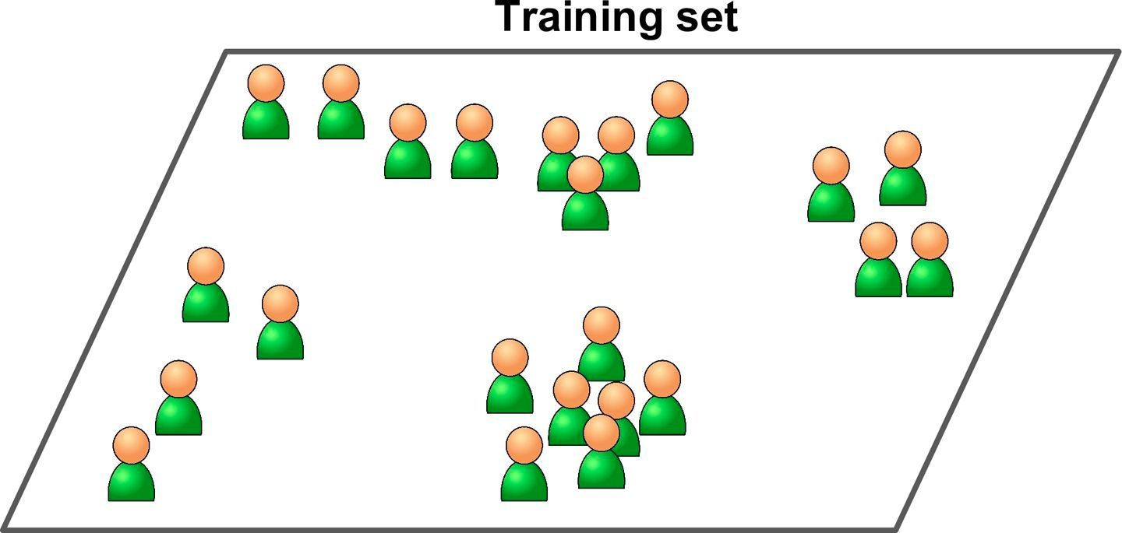
Machine Learning - Unsupervised Learning
The training data is unlabeled
The system tries to learn without a teacher
Machine Learning

Slide 4

Machine Learning - Types
Classification
Supervised
Regression
Human Supervision?
Unsupervised
Clustering
Reinforcement
Machine Learning
Learn Incrementally?
How they generalize?
Machine Learning

Slide 5
Clustering - KMeans
Clusters the data on given number of centroids
Initialize the centroids randomly
For each of instance
Pick a centroid from which the instance is at shortest distance
Assigns the instance the group
Recalculate that centroid
Keep repeat the step 2 until no instances changes the group

Slide 6
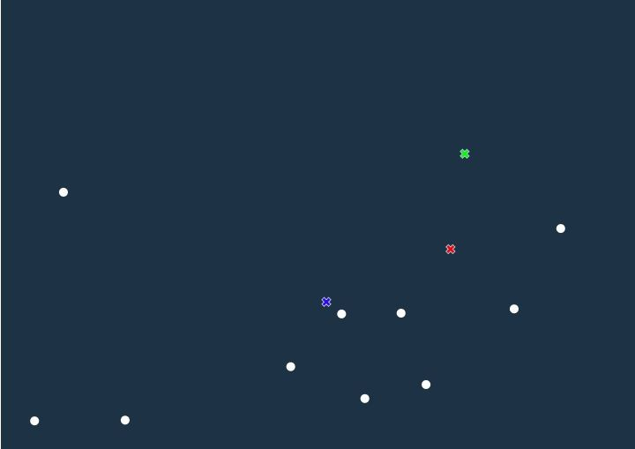
Clustering - KMeans
Initialize - 10 samples and 3 centroids
http://tech.nitoyon.com/en/blog/2013/11/07/k-means/

Slide 7
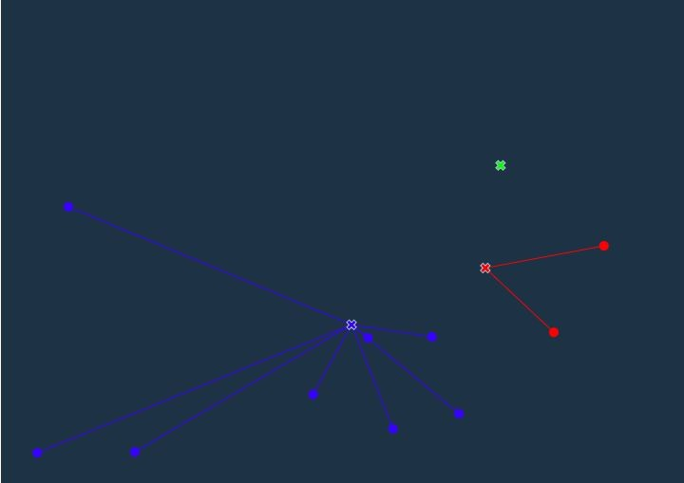
Clustering - KMeans

Slide 8
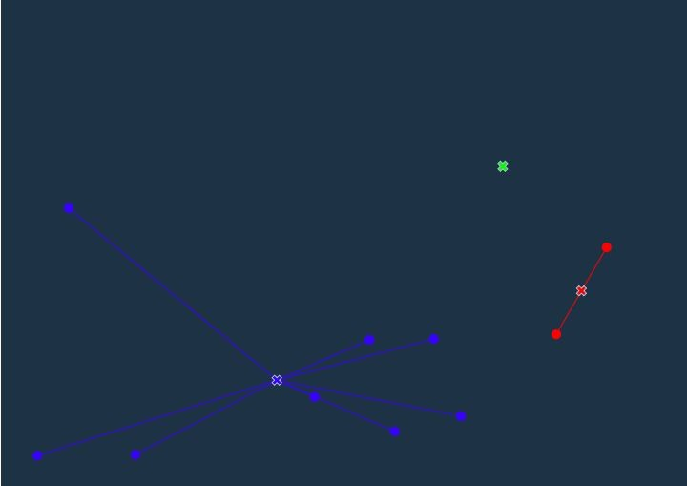
Clustering - KMeans

Slide 9
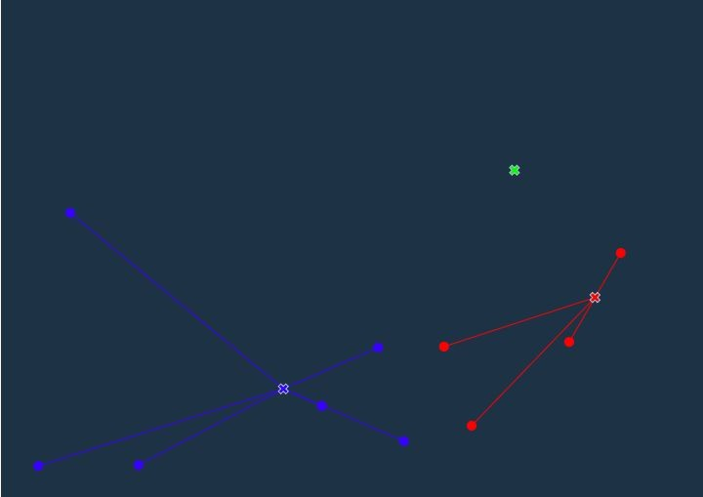
Clustering - KMeans

Slide 10
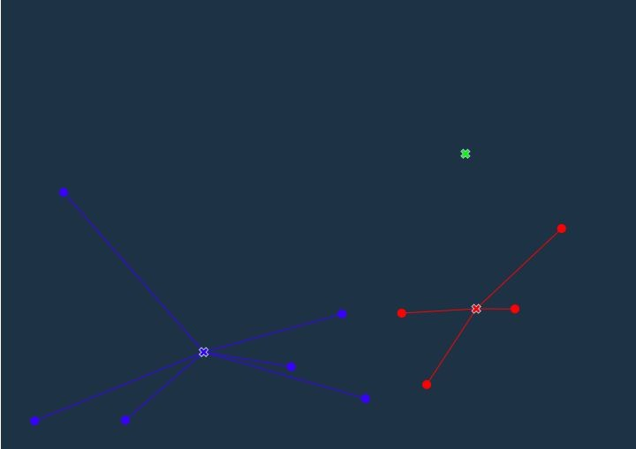
Clustering - KMeans

Slide 11
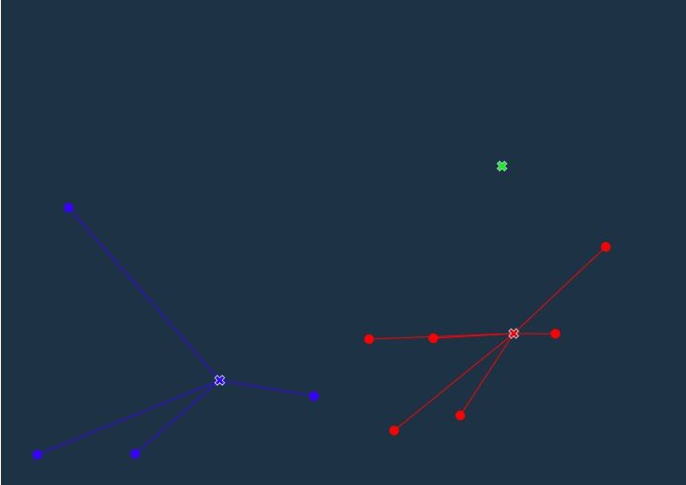
Clustering - KMeans

Slide 12
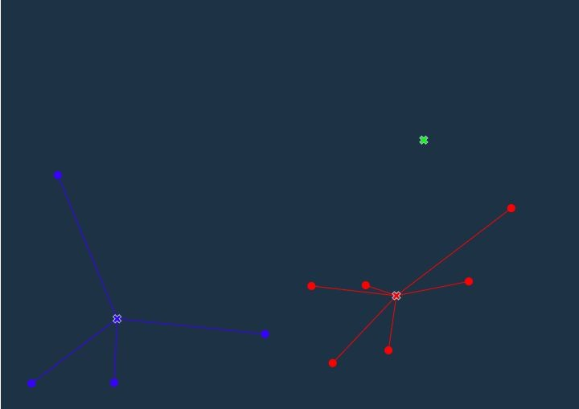
Clustering - KMeans

Slide 13
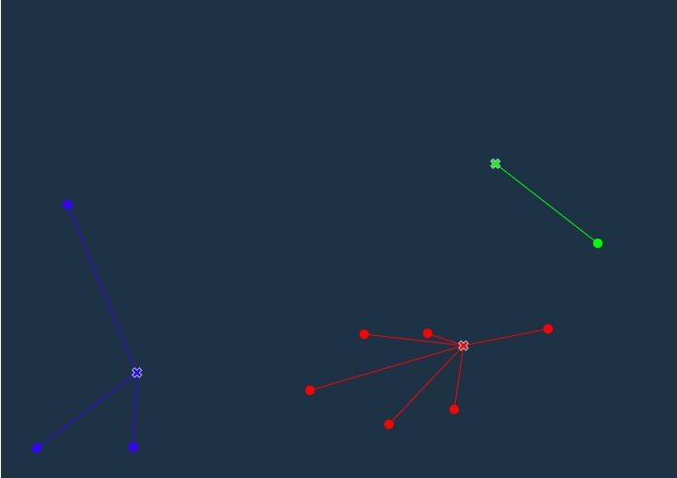
Clustering - KMeans

Slide 14
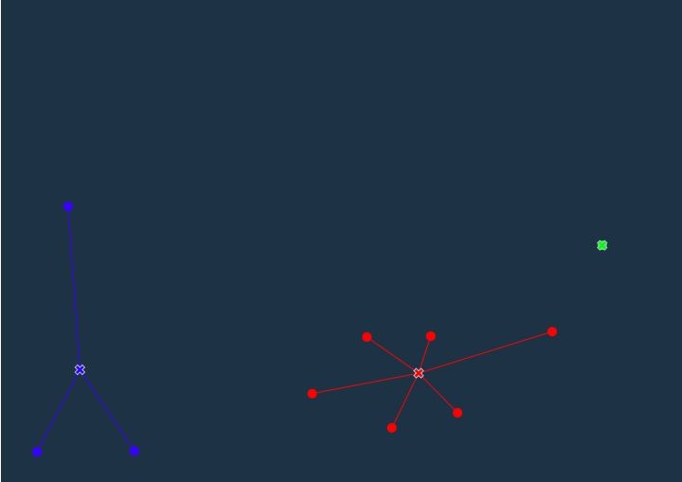
Clustering - KMeans

Slide 15
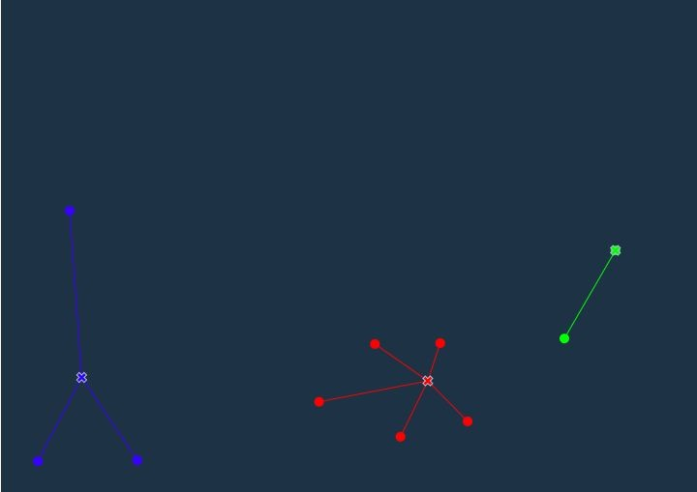
Clustering - KMeans

Slide 16
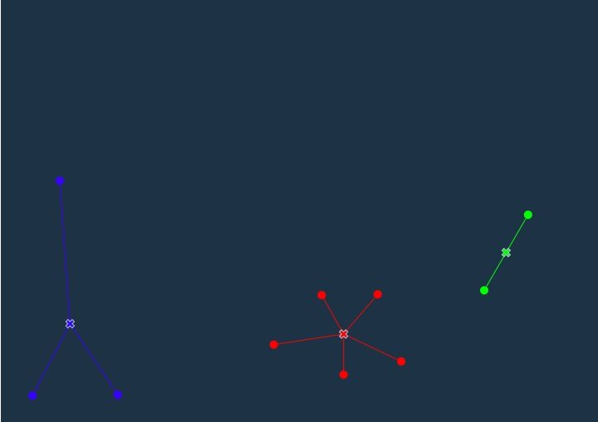
Clustering - KMeans

Slide 17

Clustering - KMeans

Slide 18
Clustering - KMeans
Let see clusters
import pandas as pd pointsdf =
pd.read_csv("/cxldata/mltut/points.csv");
import numpy as np
points = np.array(pointsdf)
xs = points[:, 0] ys = points[:, 1]
import matplotlib.pyplot as plt plt.scatter(xs, ys)
plt.show()

Slide 19
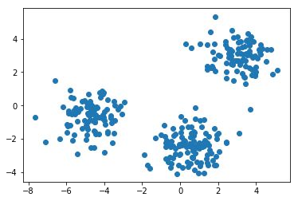
Clustering - KMeans
Let see clusters

Slide 20
Clustering - KMeans
Start using KMeans
from sklearn.cluster import KMeans
model = KMeans( n_clusters=3) model.fit(points)
clusters = model.fit_predict(points)
clusters

Slide 21
Clustering - KMeans
Start using KMeans
from sklearn.cluster import KMeans
model = KMeans( n_clusters=3) model.fit(points)
clusters = model.fit_predict(points)
clusters
new_points = [[4,3],[4,1],[-5,1]]
j = model.predict(new_points)
print(j)

Slide 22
Clustering - KMeans
Evaluating a clustering
Find inertia or withness….

Slide 23
Clustering - KMeans
Evaluating a clustering
ks = range(1, 10) inertias = []
for k in ks:
# Create a KMeans instance with k clusters: model model = KMeans(n_clusters=k)
# Fit model to samples model.fit(samples)
# Append the inertia to the list of inertias inertias.append(model.inertia_)
# Plot ks vs inertias plt.plot(ks, inertias, '-o')
plt.xlabel('number of clusters, k') plt.ylabel('inertia') plt.xticks(ks)
plt.show()

Slide 24
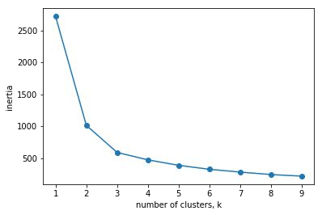
Clustering - KMeans
Evaluating a clustering
Elbow.

Slide 25
Clustering - KMeans
Evaluating a clustering - cross tab
varieties = data[:, 7]
# Create a KMeans model with 3 clusters: model model = KMeans(n_clusters=3)
# Use fit_predict to fit model and obtain cluster labels: labels labels = model.fit_predict(samples)
# Create a DataFrame with labels and varieties as columns: df df = pd.DataFrame({'labels': labels, 'varieties': varieties})
# Create crosstab: ct
ct = pd.crosstab(df['labels'], df['varieties'])
# Display ct print(ct)

Slide 26
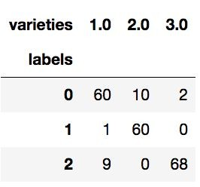
Clustering - KMeans
Evaluating a clustering - cross tab - just to show

Slide 27
Clustering - KMeans
Scale the features for KMeans.
Redo previous example with Scaling.

Slide 28
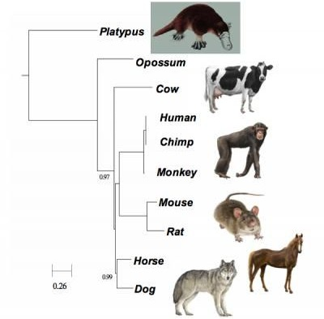
Machine Learning - Unsupervised Learning
Hierarchical Clustering - Bring similar elements together
In the form of a tree
Nodes closer to each other are similar
Machine Learning

Slide 29
Heirarchical Clustering
model = AgglomerativeClustering(n_clusters=3) model = model.fit(X)
plt.title('Auto MPG Clustering Dendrogram') plot_dendrogram(model, labels=y, leaf_rotation=90) plt.show()

Slide 30
Heirarchical Clustering
model = AgglomerativeClustering(n_clusters=3) model = model.fit(X)
plt.title('Auto MPG Clustering Dendrogram') plot_dendrogram(model, labels=y, leaf_rotation=90) plt.show()

Slide 31
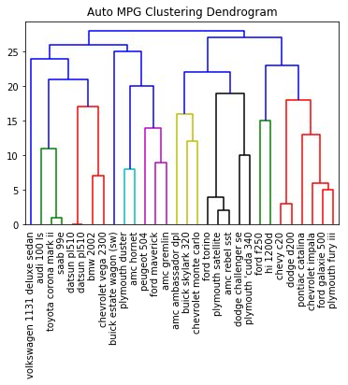
Heirarchical Clustering

Slide 32
Clustering
See: https://scikit-learn.org/stable/modules/clustering.html

Slide 33

ML Conclusion

Slide 34
Unsupervised Learning

